Slide 1


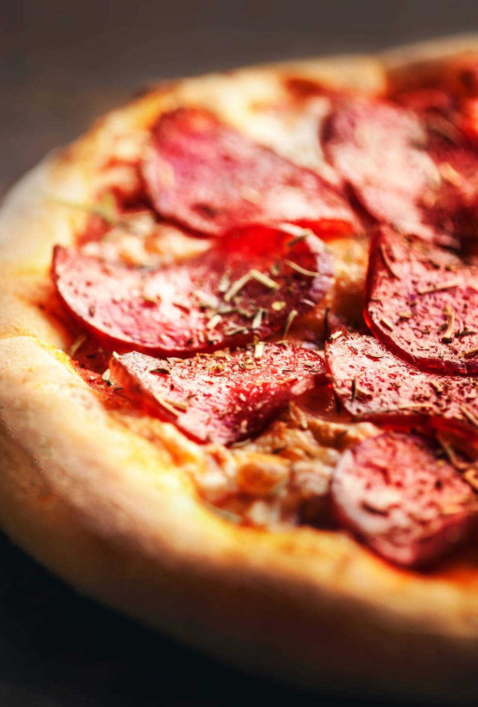
Analysis and Optimization of Operations for a Pizza Place
VIKANT KUMAR
13-08-2023

Slide 2
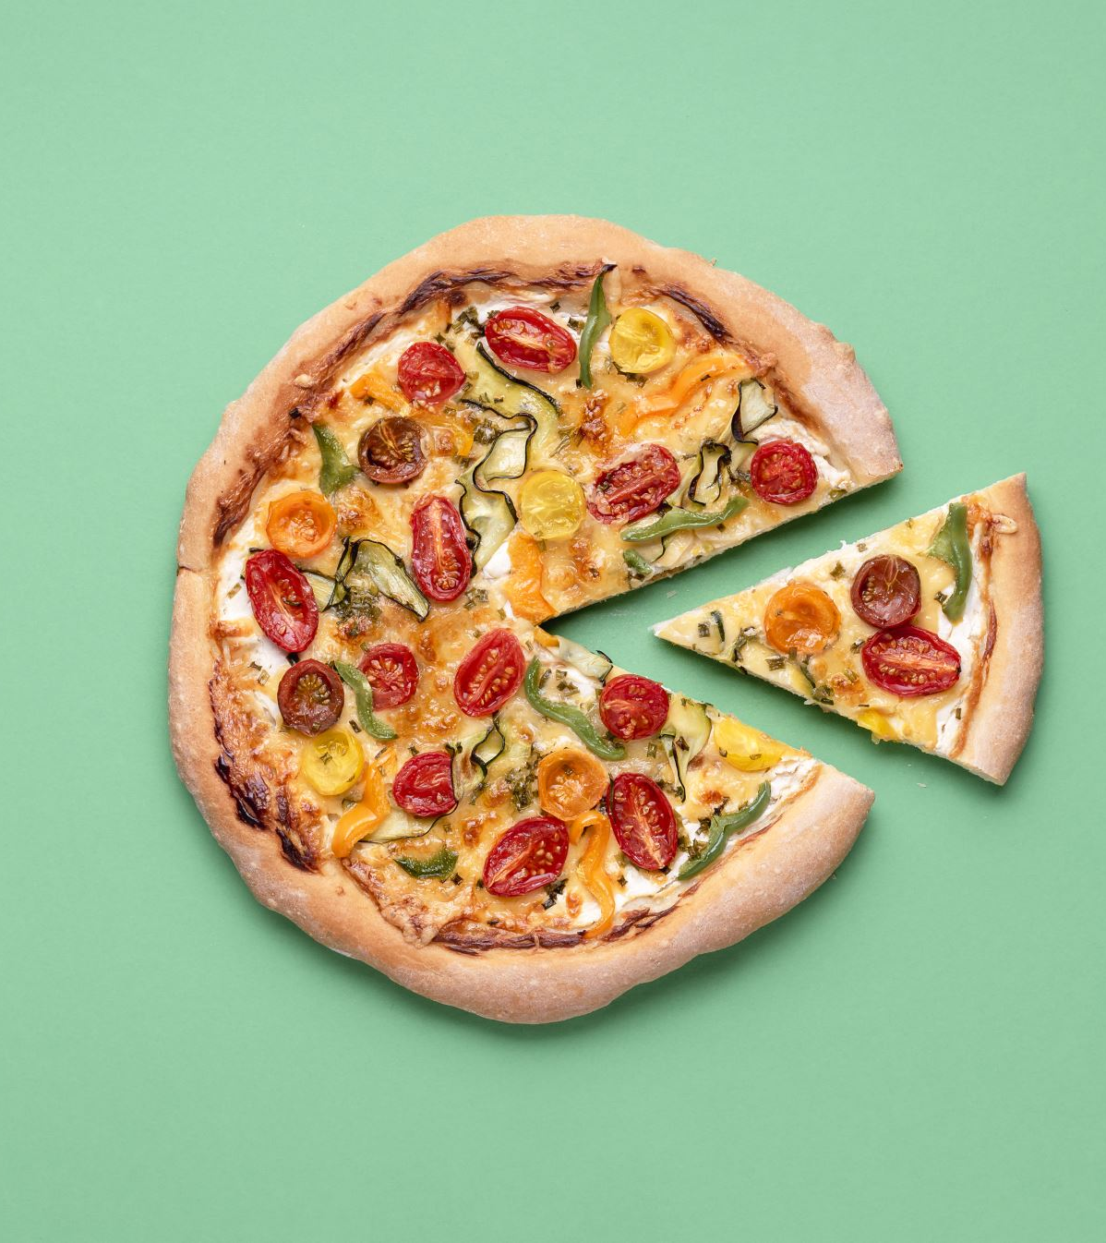
Introduction:
The dataset contains sales data for a pizza place, including the date, time of each order, and details about the pizzas served. Each entry includes information about the type, size, quantity, price, and ingredients of the pizzas.

Slide 3
FINDINGS
Customer Behavior:
Peak hours: 12PM to 1PM & 5PM to 6PM.
Average daily customers: 60.
Pizza Preferences:
Average pizzas per order: 3.
Bestsellers: Big_Meat_S.
Revenue:
Total revenue for the year: $ 801944.7
Seasonal trend: Spring season.
Menu Optimization and Promotions:
Pizzas with low sales: The_Greek_Xxl.
Promotional strategy: Introduce combo deals during peak hours and give a discount in season.

Slide 4
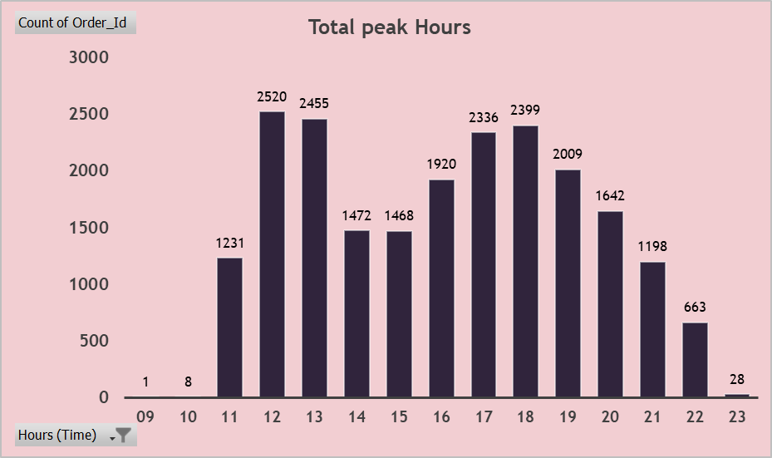
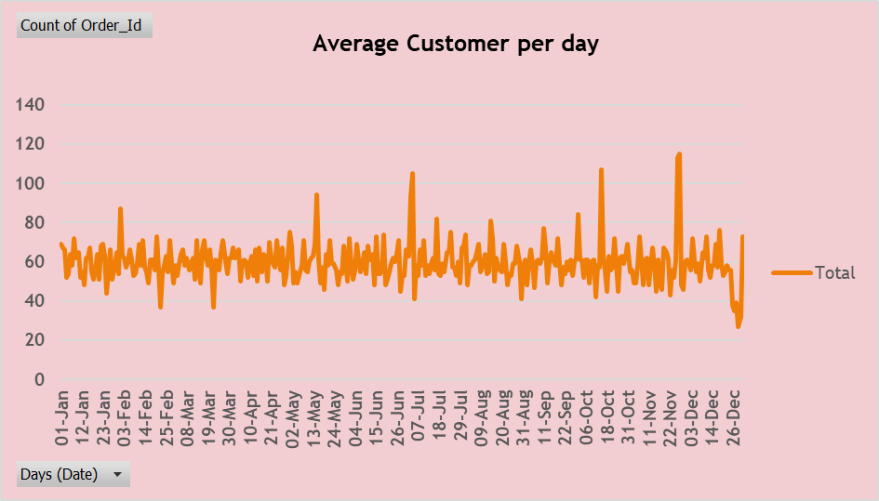
How many customers do we have each day? Are there any peak hours?
There are two Peak Hours 12PM to 1PM & 5PM to 6PM.
Total customers per day : 60

Slide 5
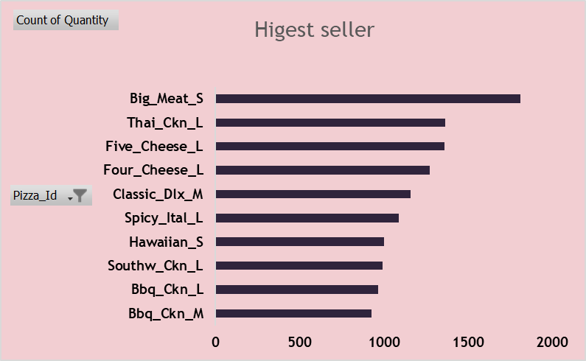
How many pizzas are typically in Order? Do we have any bestsellers?
3 pizzas are typically in order.
Big_Meat_S is a bestseller.

Slide 6

How much money did we make this year? Can we identify any seasonality in the sales?
Total money we make this year is 801944.7
We make highest sale in Spring season.

Slide 7
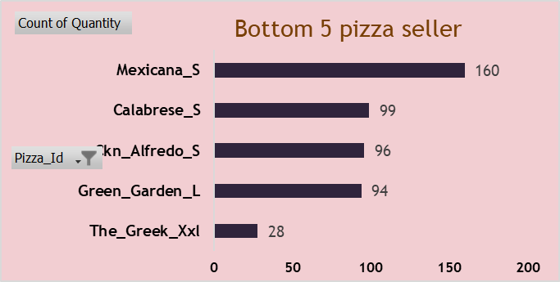
Are there any pizzas we should take off the menu, or any promotions we could leverage?
yes ,we should take off the menu The_greek_Xxl . Because of lower pizza sold in year.
Promotion: Introduce combo deals during peak hours and give best offers in season .

Slide 8

Conclusion :
This analysis of the pizza place's sales data provides valuable insights into customer behavior, pizza preferences, and revenue trends. The identified peak hours, bestselling pizzas, and seasonal revenue patterns can aid in optimizing operations and increasing profitability. The recommendations for menu adjustments and promotions offer actionable strategies to enhance the business's success.

Slide 9


